Slide 1


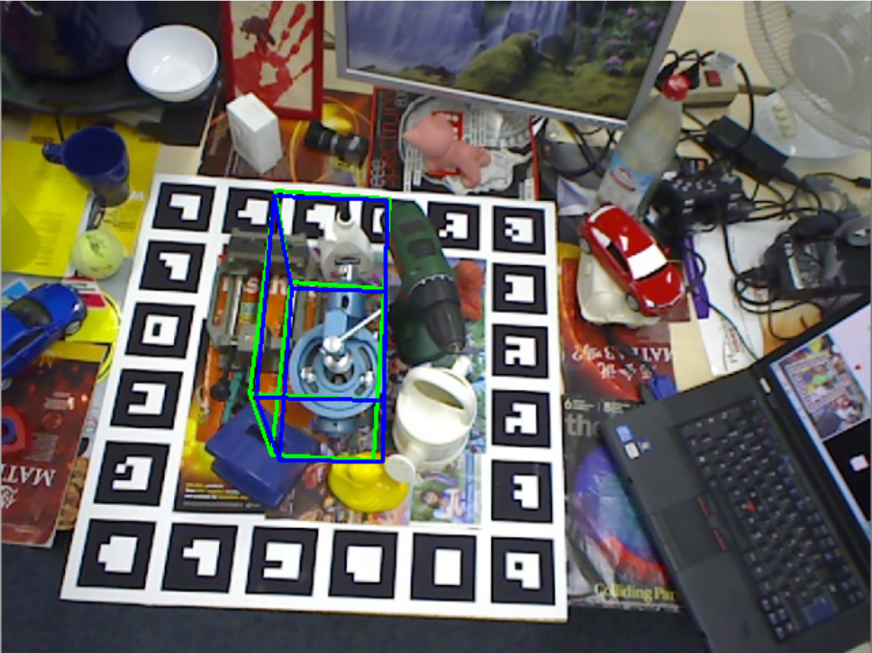
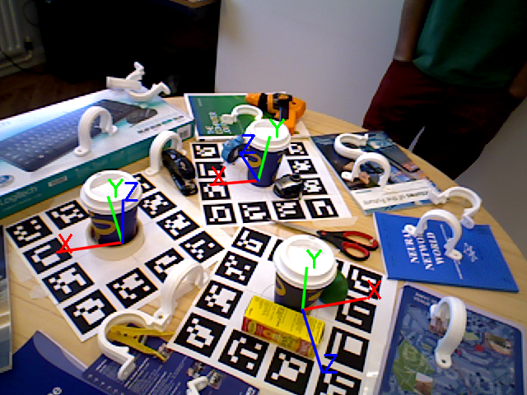
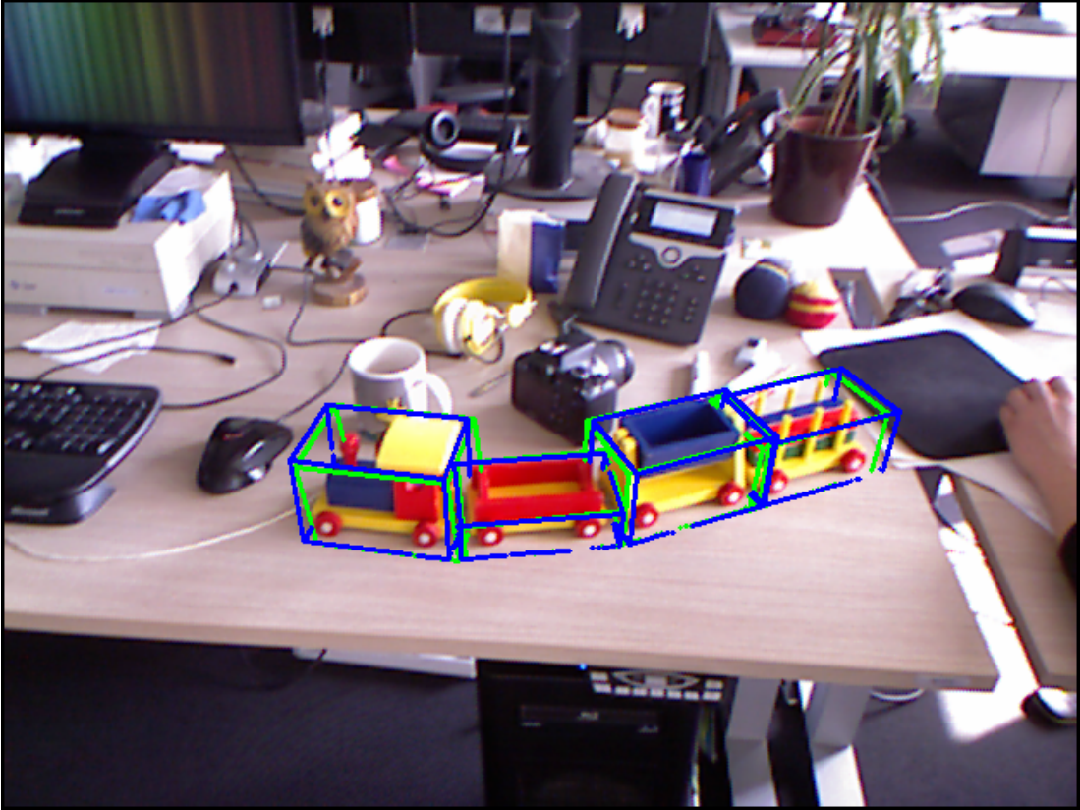
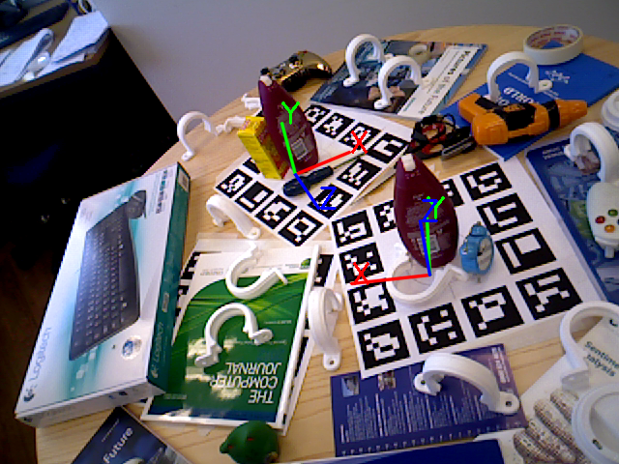
ICCV Workshop on Recovering 6D Object Pose
Tae-Kyun Kim, Carsten Rother, Vincent Lepetit, Jiri Matas, Ales Leonardis, Rigas Kouskouridas
December 17th, 2015

Slide 2
Statistics
12 extended abstracts have been submitted, and they are presented as spotlights and posters.
2 demos on site for 6D object pose recovery.
We will present the best poster award ($200) sponsored by

Slide 3
Awards
All organisers and invited speakers participated at the voting.
A single vote per person was allowed for the best poster award ($200).

Slide 4
Best Poster
E. Munoz, Y. Konishi, V. Murino, A. Del Bue
for their work
Efficient 6D Pose Estimation of Texture-less Objects from a Single RGB Image

Slide 5
What we should do next
Comprehensive list of state of the art 6D object pose estimation methods and datasets
http://www.iis.ee.ic.ac.uk/ComputerVision/6D_Object.html
Robotics?

Slide 6
Thank you

